Slide 1
Encoders & Decoders in Deep Learning
Encoder
Converts original data into a secret code.
Uses rules or transformations to hide the message.
Decoder
Reverts the secret code back to the original data.
Understands the rules to reverse the encoding.
Enables understanding of the hidden message.

Slide 2
What Are Autoencoders?
A type of neural network designed for dimensionality reduction and feature learning.
Primary goal: To encode data into a compact representation and then decode it for reconstruction.

Slide 3
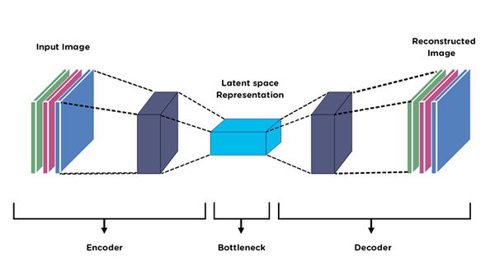
Anatomy of an Autoencoder
Components: Encoder, Bottleneck/Hidden Layer, Decoder.

Slide 4
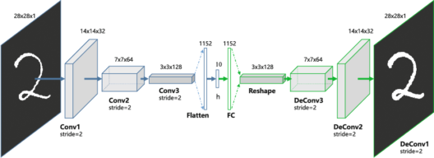
Anatomy of an Autoencoder
Components: Encoder, Bottleneck/Hidden Layer, Decoder.

Slide 5
Encoder
The encoder is like a detective that learns to capture the most important features of an image or data.
It's the first part of the autoencoder and responsible for compressing the input data.

Slide 6
How Does the Encoder Work?
Imagine an encoder as a funnel that squeezes a big picture into a smaller representation.
It transforms the input data (e.g., an image) into a compact form called the latent space or encoding.

Slide 7
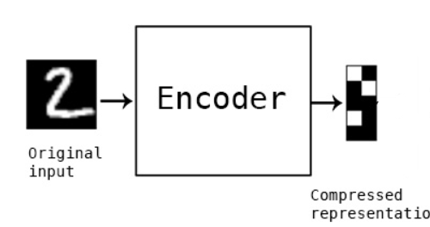
Encoding Process
Step 1: The input data, such as an image, is fed into the encoder.
Step 2: The encoder consists of layers of neurons that learn patterns and features in the data.
Step 3: These patterns are combined and transformed into a compact representation in the latent space.

